Slide 1
Project
Overview
Electricity Bill Payment System
vision & strategy

Slide 2
Introduction
This presentation outlines a full stack development project focused on creating an Electricity Bill Payment System. The project integrates frontend and backend technologies to deliver a seamless user experience. It highlights key components, design choices, and technical implementations that enable efficient bill management and payment processing.

Slide 3
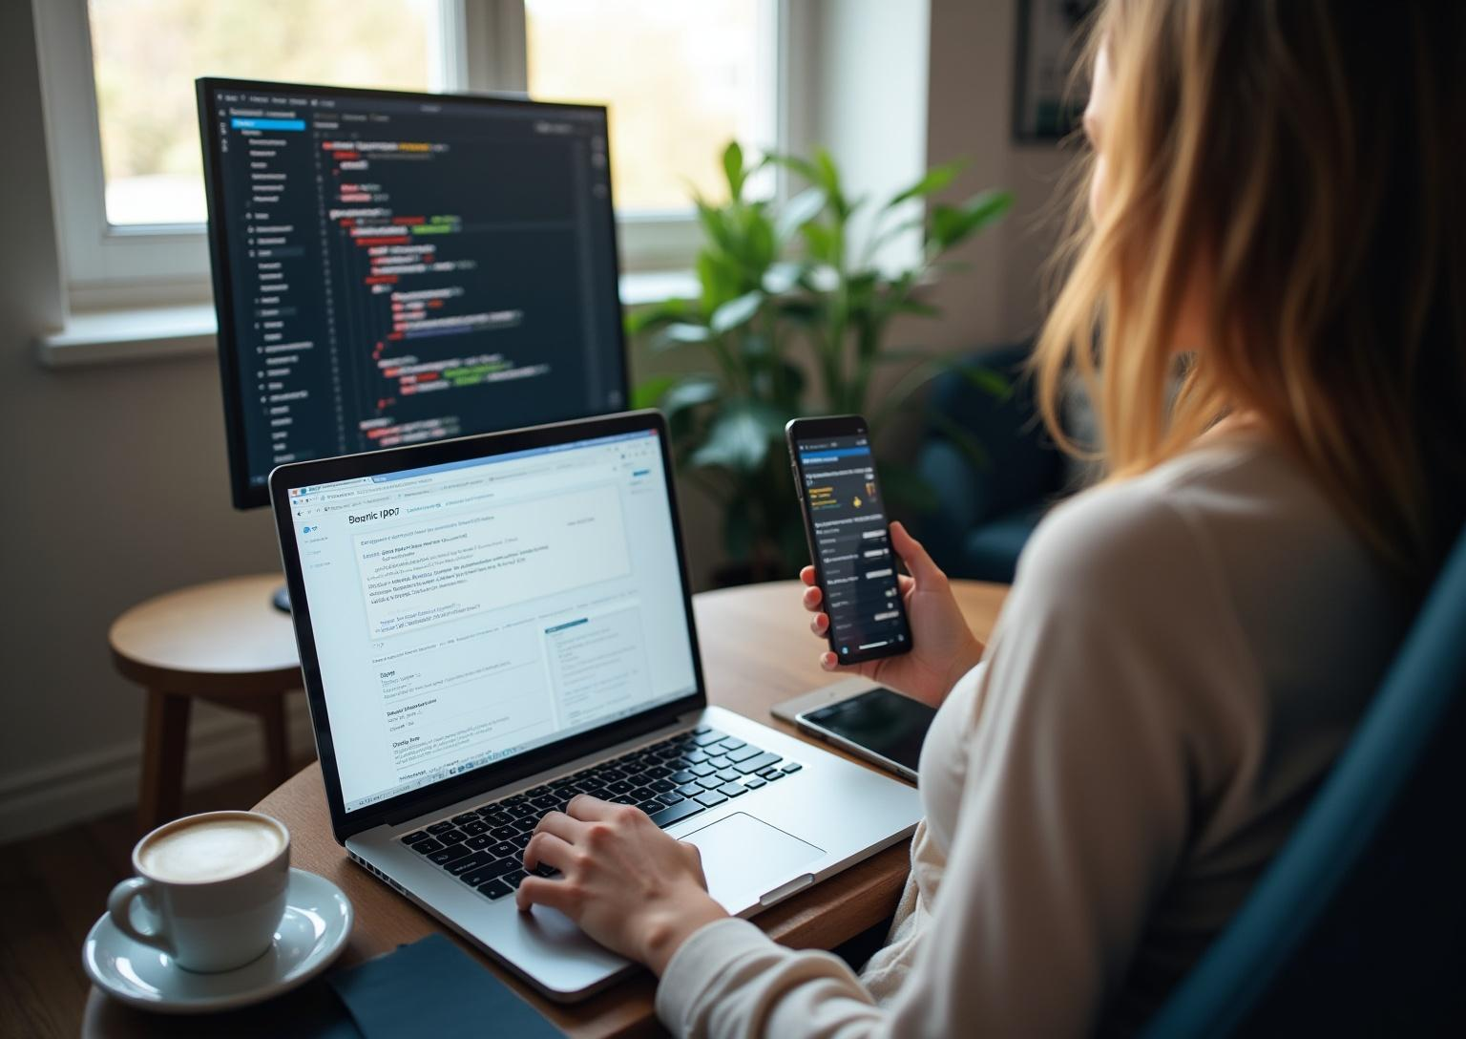
Frontend Technologies
Used
The frontend was built using html and css for dynamic user interfaces, ensuring responsive and accessible design.CSS frameworks aided in consistent styling.

Slide 4
Backend Technologies and Database
The backend is powered by python ,django with Express for server-side logic, handling user requests and business workflows

Slide 5
Integration and Deployment
The system integrates frontend and backend components using HTML ,python and css. Continuous integration and automated testing were implemented to maintain quality and streamline updates, ensuring the system remains stable and responsive under varying user loads.

Slide 6
Electricity Bill Payment System Project

Slide 7
System Features and User Flow
The system allows users to register, log in, view their electricity bills, and make secure payments online. It features real-time bill calculation, payment history tracking, and notification alerts for due dates. The user flow is designed to be intuitive, minimizing steps and enhancing overall user experience.

Slide 8
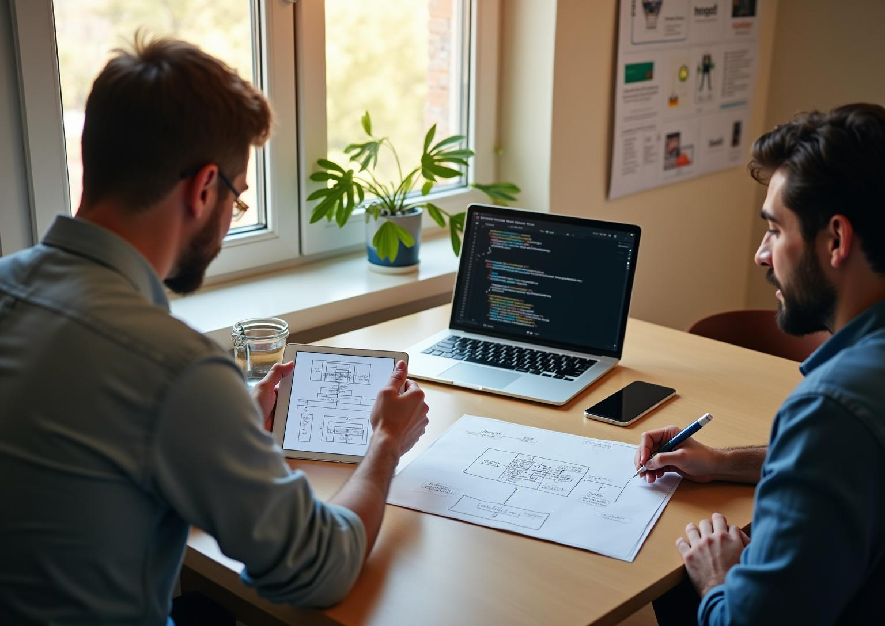
Technical Architecture and
Implementation
The architecture follows a client-server model .database management, storing user data and transactions securely. The implementation includes authentication, payment gateway integration, and error handling to ensure data integrity and secure processing.

Slide 9
Challenges and Learning Outcomes
Key challenges included integrating secure payment processing and managing asynchronous data flow. Overcoming these improved problem-solving and debugging skills. The project provided valuable hands-on experience with full stack technologies, strengthening understanding of end-to-end application development and deployment.

Slide 10
Conclusions
The Electricity Bill Payment System successfully combines robust technologies to deliver a secure and user-friendly solution. The project enhanced skills in full stack development, system integration, and deployment strategies. Future improvements could include adding mobile support and enhanced analytics to further enrich user engagement and operational efficiency.

Slide 11
THANK
YOU.
Do you have any questions?
youremail@freepik.com
+00 000 000 000
yourwebsite.com
please keep this slide for attribution

